Slide 1
CLASS 9
Dated 5th March 2025
Course Title: 5G and Wireless Technology
Course Code : ECE829
MODULE 4 of the Syllabus:-
5G Use Case 2: IIIT KALYANI’s 5G Smart Gangasagar Island Project with Large Rack 5G , Small Portable NIBs and their integration
to solve problems of
i) Ultra Reliability using AI at Underserved Areas in Vessels/Boats ii) Service Continuity at Unserved Areas in Mid Sea iii)Congestion Avoidance at Crowd areas like Kapil Muni ashram,Gangasagar
Prof.(Dr.) Rabindranath Bera (Professor, IIIT, KALYANI)
E-mail: rbera@iiitkalyani.ac.in; Mobile : 9475513358
i

Slide 2
Today’s CLASS : 5G USE CASE 2: ITEM 1 with ONE CELL (Ultra Reliability using AI at Underserved Areas in Vessels/Boats )

Slide 3
CLASS 9
Dated 26t h FEBRUARY , 2025
Course Title: 5G and Wireless Technology
Course Code : ECE829
MODULE 4 of the Syllabus:-
5G Use Case 2: IIIT KALYANI’s 5G Smart Gangasagar Island Project with Large Rack 5G , Small Portable NIBs and their integration
to solve problems of
i) Ultra Reliability using AI at Underserved Areas in Vessels/Boats ii) Service Continuity at Unserved Areas in Mid Sea iii)Congestion Avoidance at Crowd areas like Kapil Muni ashram,Gangasagar
Prof.(Dr.) Rabindranath Bera (Professor, IIIT, KALYANI)
E-mail: rbera@iiitkalyani.ac.in; Mobile : 9475513358
i

Slide 4
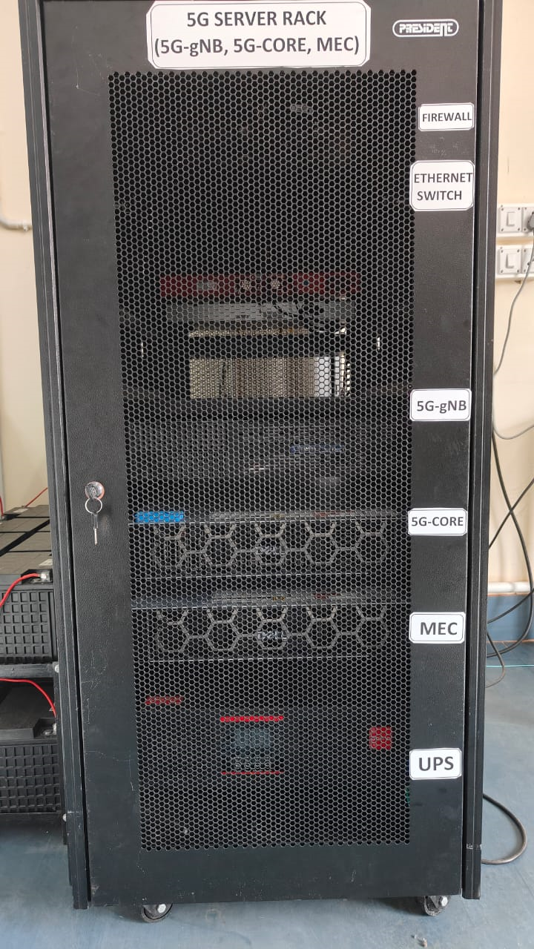
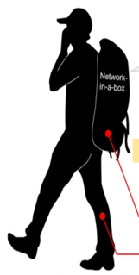
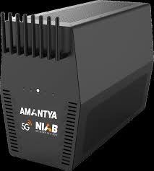
Motivation
‘ONE BOX NIB (Network-In-a-Box) Implementation’ : of 5G Split Open v-RAN
‘LARGE RACK Implementation’: of 5G Split Open
v-RAN Architecture
[OPERATIONAL at IIIT, KALYANI] [ PROPOSED DEVELOPMENT at IIIT, KALYANI]
5G NIB Portable RADIO Base Station carryable in a bag
New Era in RAN Evaluation
140 GHz 6G NIB ensures URLLC
LAPTOP /Raspberry PI type Computer within NIB as Portable Data Center

Slide 5
Motivation
Initial Experiment was successfully conducted by Prof. R. Bera and the Group at Gangasagar Island to study Sea water Impact on Radio wave propagation in a Project sponsored by DRDO, Hyderabad which can claim to be world First category of Channel Sounding Experiment for 5G Communication
The Data out of this experiment was used by IIIT KALYANI’s 5G Smart Gangasagar Island Project with LARGE RACK 5G ,Small Portable NIBs and their INTEGRATION to solve problems of i) Ultra Reliability using AI at Underserved Areas in Vessels/Boats ( Design and development of 5G NIB with One Cell Use Case during Short Stretch of Journey over Sea Water Channel)
Further,The Single cell is extended to 5G NIB with Three CELLs Use cases during Long Stretch of Journey over Sea Water Channel Ensuring Service Continuity in Integrated Terrestrial and Satellite Non-Terrestrial Network (TN-NTN) and Use Cases in Water Vehicles with Infotainment, IoT and IoV services
Further, Congestion Avoidance at Crowd areas like Kapil Muni ashram,Gangasagar was initiated in the design for 5G NIB with Five CELLs Use cases
We will approach to West Bengal State Government to utilize this USE CASE 2 for Implementation of above 5G-Advanced Infrastructure 2.0 based Private Network at nearby areas surrounding Gangasagar Island

Slide 6
Outline of Presentation of Previous Class
5G RAN ARCHITECTURE Further Evoluation
‘LARGE RACK Implementation’: of 5G Split Open v-RAN Architecture revisited
Use Case 1: Large Rack Implementation at IIIT , Kalyani
‘ONE BOX NIB (Network-In-a-Box) Implementation’ : of 5G Split Open v-RAN Architecture
WEBINAR 1: Unlocking the True Potential of 5G with Network-in-a-box [ https://www.youtube.com/watch?v=5peyqzkgfXc&t=4s]
WEBINAR 2: Exploring the Benefits of 5G Labs for Colleges and Universities | Amantya Technologies [ https://www.youtube.com/watch?v=zh9XJPZlGQw]
Review on ‘5G/6G NIB’ (Network-In-a-Box): Objective, Paper 1 Edge Task Migration With 6G-Enabled Network in Box for Cybertwin-Based Internet of Vehicles
INTER-OPERABILITY among LARGE RACK 5G and NIBs and their INTEGRATION
Use Case 2: IIIT KALYANI Debuts Smart Island (Running Project ) with DELL Servers having Intel® Xeon Gold 3.0 GHz 5317 x 2 processor
Project ‘SMART_GANGASAGAR ’ sponsored by DRDO: IIIT, KALYANI 5G O-RAN / V-RAN Architecture DEPLOYMENTS over SEA/ISLAND Communication at or surrounding Gangasagar with Five Cells
5G NIB with One Cell Use Case during Short Stretch of Journey over Sea Water Channel:
AI enabled 5G Vessels with 5G URLLC Slice operational at Gangasagar Island
5G NIB with Three CELLs Use cases during Long Stretch of Journey over Sea Water Channel: :
Ensuring Service Continuity in Integrated Terrestrial and Non-Terrestrial Network (TN-NTN) and Use Cases in Water Vehicles with Infotainment, IoT and IoV services
5G NIB with Five CELLs Use cases for above service extension at or nearby areas surrounding Gangasagar Island:
Design and Implementation of 5G-Advanced Infrastructure 2.0 based Private Network at nearby areas surrounding Gangasagar Island

Slide 7
Outline of Presentation
Problem of Radio Wave Propagation : Case Study of a Specific Wireless Channel.
Solution for performance restoration against Problem of Radio Wave Propagation using Artificial Intelligence in 3GPP 5G-Advanced
Webinar by R&S : Towards an AI-native air interface in 6G
IIIT Kalyani work ‘ Smart Island Project ’ and realization of 5G NIB with One Cell Use Case
Compare R&S work ‘AI-native air interface in 6G’ with IIIT Kalyani work ‘ Smart Island Project ’

Slide 8
Outline of Presentation
Problem of Radio Wave Propagation : Case Study of a Specific Wireless Channel.
Solution for performance restoration against Problem of Radio Wave Propagation using Artificial Intelligence in 3GPP 5G-Advanced
Webinar by R&S : Towards an AI-native air interface in 6G
IIIT Kalyani work ‘ Smart Island Project ’ and realization of 5G NIB with One Cell Use Case
Compare R&S work ‘AI-native air interface in 6G’ with IIIT Kalyani work ‘ Smart Island Project ’

Slide 9
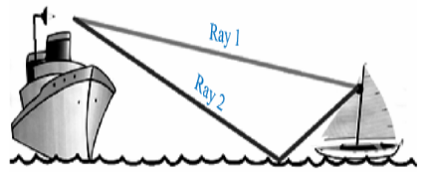
Outline of Presentation
Problem of Radio Wave Propagation : Case Study of a Specific Wireless Channel.
Problem Definition of Maritime 5G Radio Channel: Multipath Radio Signal FADING at the 5G reception Terminal
Artificial Intelligence in 3GPP 5G-Advanced: A Survey
Problem Definition of Maritime 5G Radio Channel
Webinar bProblem Definition of Maritime 5G Radio Channely R&S : Towards an AI-native air interface in 6G
Summary and Conclusion

Slide 10
Multipath DEMO using SYSTEMVUE software

Slide 11
Path 1 CIR
Path 2 CIR ( Channel Impulse response)
The Problem of Superposition of Path 1 CIR and Path 2 CIR( Delayed) will cancel the Resultant Reception Signal

Slide 12
Problem Definition of Maritime 5G Radio Channel
The most important prerequisite for the 5G maritime communication system is the analysis of the sea water radio channel.
In this section, we discuss the problem of seawater on radio wave propagation impacting the communication system severely. The seawater radio channel produces lots of multipath rays i.e., Ray 1(Direct LOS ray) and Ray 2 (multipath reflected rays from the surface of the seawater). The communication channel will be disturbed by the multipath reflected rays from sea water which acts as a distributed mirror. Both the LOS ray and reflected rays will be superimposed and creates problem in communication. Also, tidal waves play a major role in these signal fluctuations.
On this context, we have conducted a propagation experiment to study the problems of seawater radio waves in 5G communication in remote islands. sponsored by DRDO, Hyderabad

Slide 13
Propagation Experiment of Maritime 5G SEA Channels
To implement a 5G in remote islands, we experimented on radio wave propagation measurement at a remote island Gangasagar Island, West Bengal, India).
We have conducted a propagation experiment to study the problem of seawater radio waves in 5G communication. In this experiment, we have kept the transmitter at the Rooftop of a 2nd floor building at Kachuberia, Gangasagar Island, and the receiver at the Rooftop of another 2nd floor building at Kakdwip. The LOS link was established over the river using Two radios at 11.5 GHz and 12.5 GHz which is severely affected by sea water time to time.
The above experiment was conducted by placing
• One Ku Band antenna and transmitter at Kachuberia, GangaSagar
• Another antenna and receiver at Kakdwip 8 No. Jetty.
• We successfully established a 5G P2P (Point to Point) communication link between one point towards the land side at Kakdwip, west Bengal, and another point at Sagar Island over the Bay of Bengal.
• The wireless channel is the seawater in between the two points which is very dynamic and random creating severe fading and impairments to the communication system.

Slide 15
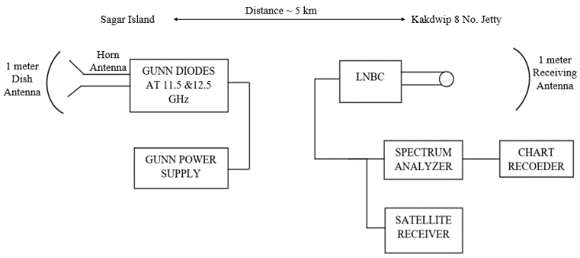
The above experiment was conducted by placing
•One Ku Band antenna and transmitter at KACHUBERIA, GANGASAGAR
•Another antenna and receiver at Kakdwip 8 No. Jetty as shown in Figure below.
LNBC ... Low Noise Block Converter
Fig. : Experimental Set up to Analyze /Estimate the Sea Environment at Sagar Island, West Bengal

Slide 16
Table 6.1: Link Budget of 5G Communication Link
Parameters | Value
Distance between Transmitter and Receiver | 5 km
Transmitter Ku Band Antenna Height | 1 m
Receiver Ku Band Antenna Height | 1 m
Receiver Ku Band Antenna Gain | 39.2 dB
Receiver Ku Band Antenna Gain | 39.2 dB
Gun Diodes | 11.5 GHz & 12.5 GHz
Gun Diode Voltage | 12V

Slide 17
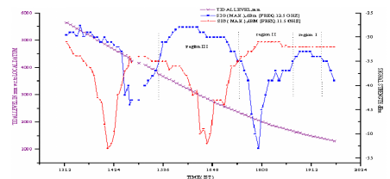
Fig 6.9: Results Explaining the Necessity of Frequency Diversion in 11.5 and 12.5 GHz 5G System at Sea Environment (Sagar Island)

Slide 18
As shown in Figure 6.9, the authors have successfully conducted a propagation experiment . The propagation experiments are conducted with the different heights of the tidal waves with two different Radio carrier frequencies 11.5 GHz and 12.5 GHz.
Results are divided into Three regions i.e., Region I, Region II, and Region III at different time intervals (IST) with different Tidal Heights which is also plotted in the same graph.

Slide 19
we can observe that the signal reception is exceptionally Good in region I in both carrier frequencies.
In Region II, when the tidal height gets fluctuate, the signal strength at 11.5 GHz carrier frequency is exceptionally good but the signal strength deteriorated at 12.5 GHz carrier frequency in a different time interval.
Similarly, in Region III, the signal strength at 12.5 GHz carrier frequency is exceptionally good but the signal strength deteriorated at 11.5 GHz carrier frequency in a different time interval. The signal distortion at the different regions is due to the fluctuation of tidal waves at different time intervals. The additional multipath effects due to the seawater surface reflection cause severe effects on radio waves because of the salinity of the seawater which is very dangerous to radio waves. The signal fading of received signal in both the carrier frequencies are 30 dB. The summary of propagation at different regions is shown in Table 6.2.

Slide 20
Table 6.2: Summary of Propagation Experiment Over 5G-NTN-SEA-SMIT Channel
Region Marked on the Curve | Sea Tidal Level (mm) concerning Local Datum | Received Signal Strength (dB) 11.5 GHz Reception | Received Signal Strength (dB) 12.5 GHz Reception | Remarks
Region I | 1000-1500 | -33 | -35 | Excellent Reception No Sea Clutter/Multipath Reception
Region II | 2000-2500 | -31 | -52 | i) Excellent Reception at 11.5 GHz Carrier Frequency ii) Poor Reception at 12.5 GHz Carrier Frequency with a fading depth of 30 dB
Region III | 3000-3500 | -54 | -29 | i) Poor Reception at 11.5 GHz Carrier Frequency with a fading depth of 30 dB ii) Excellent Reception at 12.5 GHz Carrier Frequency

Slide 21
Outline of Presentation
Problem of Radio Wave Propagation : Case Study of a Specific Wireless Channel.
Solution for performance restoration against Problem of Radio Wave Propagation using Artificial Intelligence
Webinar by R&S : Towards an AI-native air interface in 6G
IIIT Kalyani work ‘ Smart Island Project ’ and realization of 5G NIB with One Cell Use Case
Compare R&S work ‘AI-native air interface in 6G’ with IIIT Kalyani work ‘ Smart Island Project ’
Relax and watch for the Video Webinar
https://drive.google.com/file/d/1XFCHw5OU2tM1_5cXVmQIOSla6keneHxE/view?usp=drive_link

Slide 22
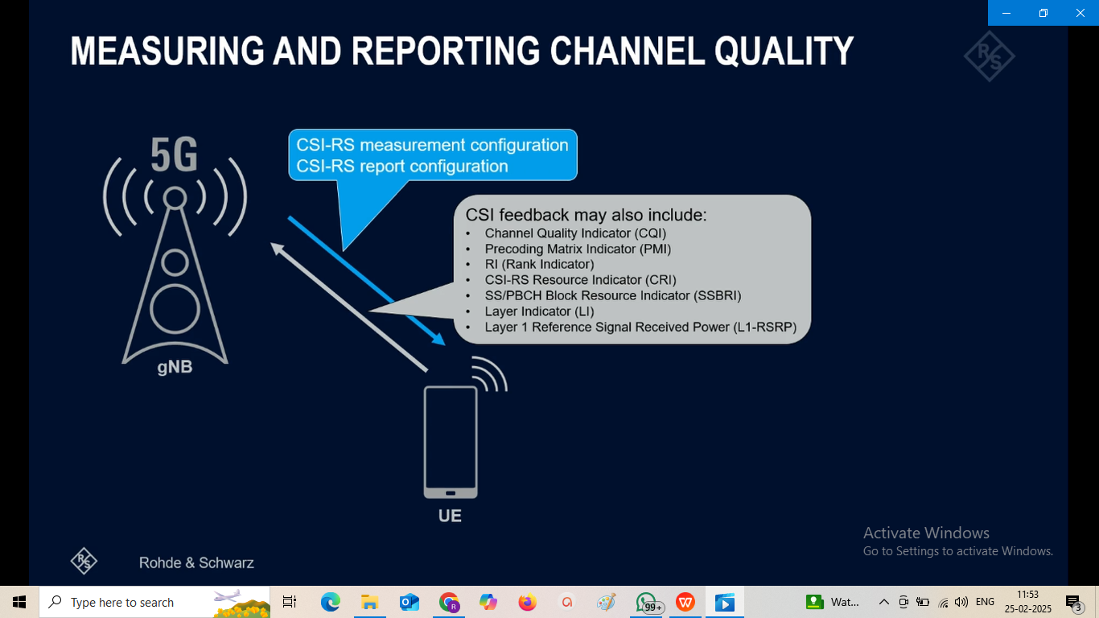
Channel State Information Reference Signal (CSI-RS)

Slide 23
CSI Feedback with Autoencoders
In conventional 5G radio networks, CSI parameters are quantities related to the state of a channel that are extracted from the channel estimate array. The CSI feedback includes several parameters, such as the Channel Quality Indication (CQI), the precoding matrix indices (PMI) with different codebook sets, and the rank indicator (RI). The UE uses the CSI reference signal (CSI-RS) to measure and compute the CSI parameters. The user equipment (UE) reports CSI parameters to the access network node (gNB) as feedback. Upon receiving the CSI parameters, the gNB schedules downlink data transmissions with attributes such as modulation scheme, code rate, number of transmission layers, and MIMO precoding. This figure shows an overview of a CSI-RS transmission, CSI feedback, and the transmission of downlink data that is scheduled based on the CSI parameters

Slide 24
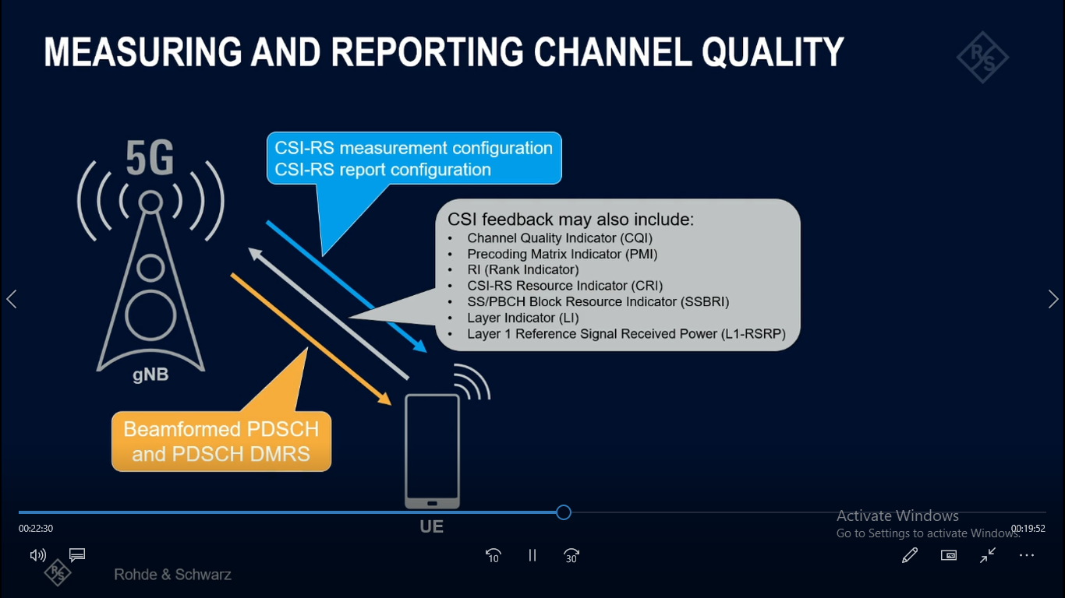

Slide 25
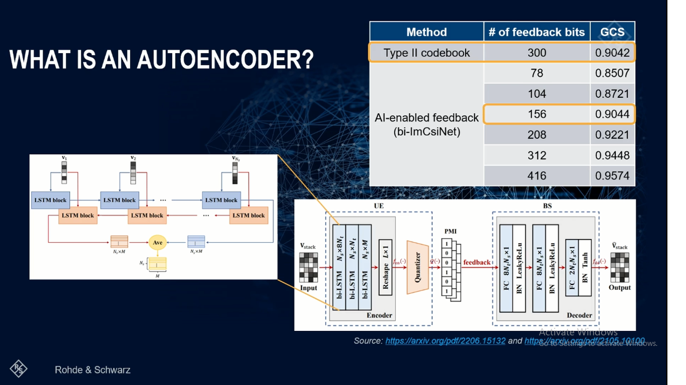

Slide 26
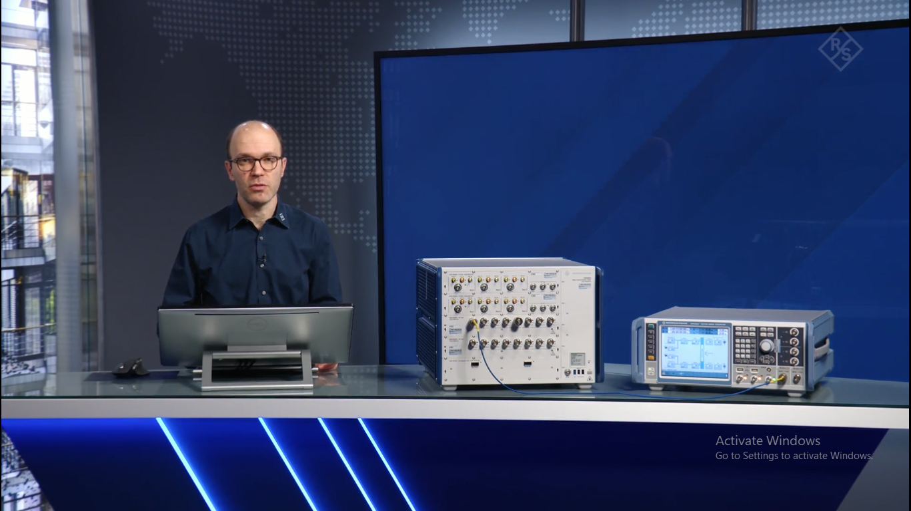

Slide 27
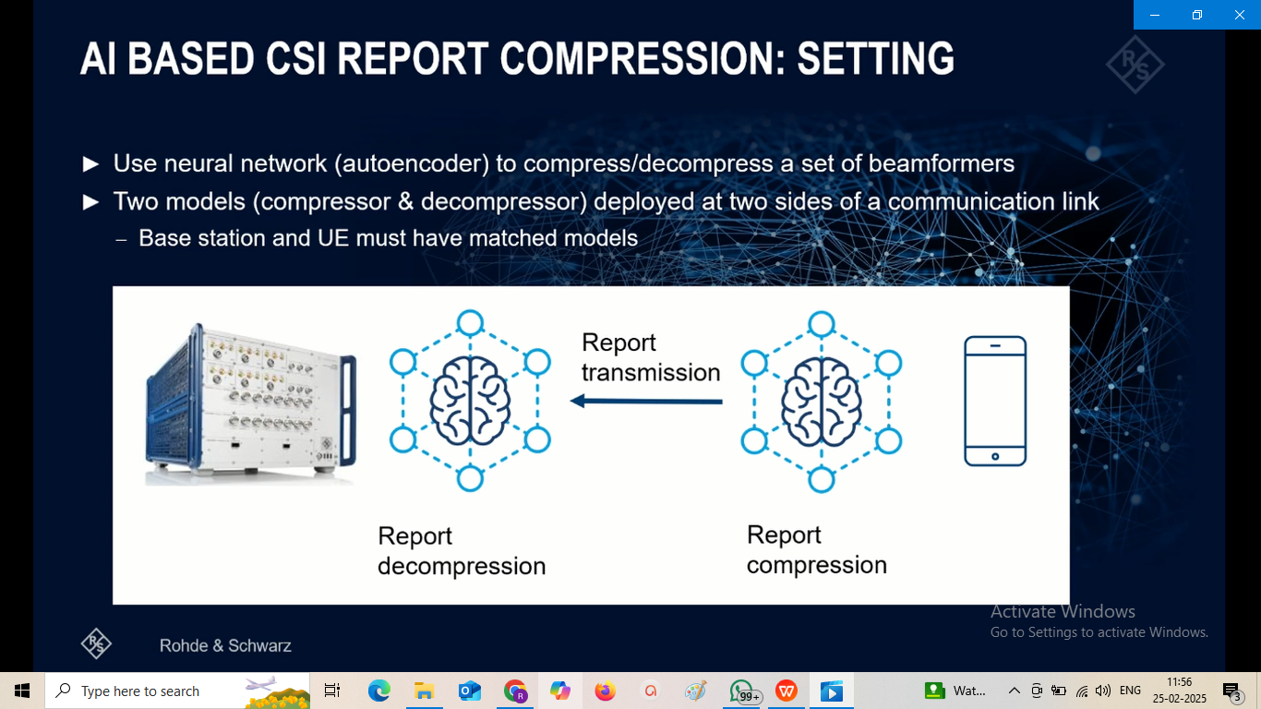

Slide 28
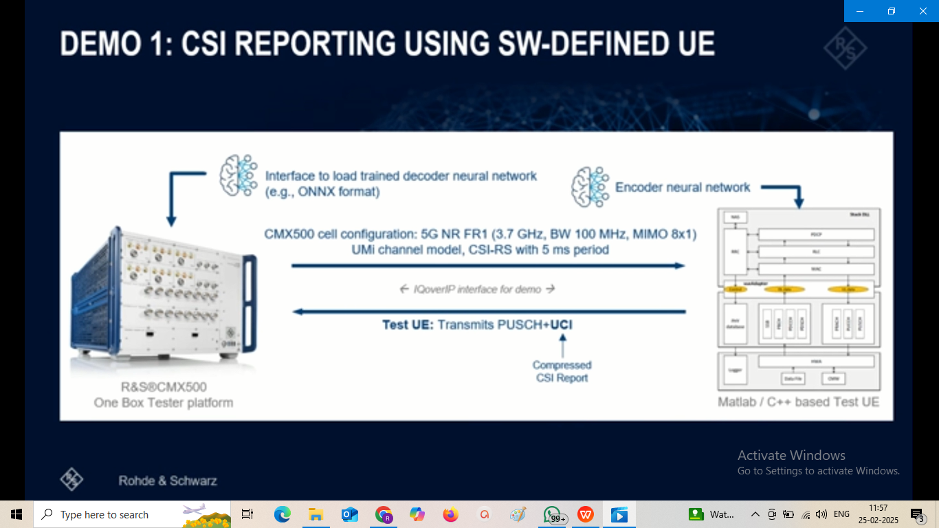

Slide 29
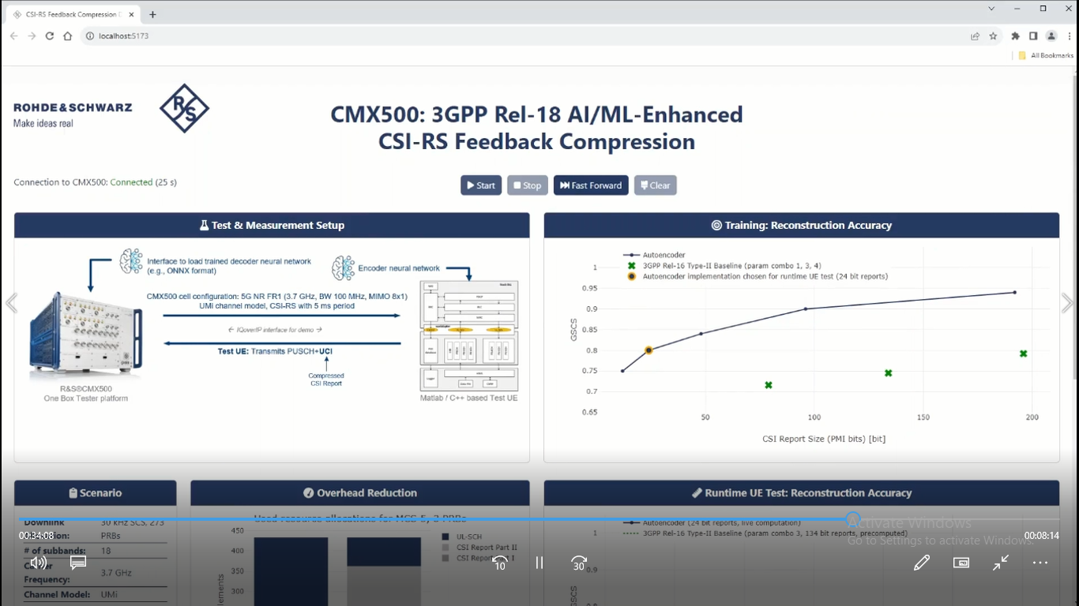

Slide 30
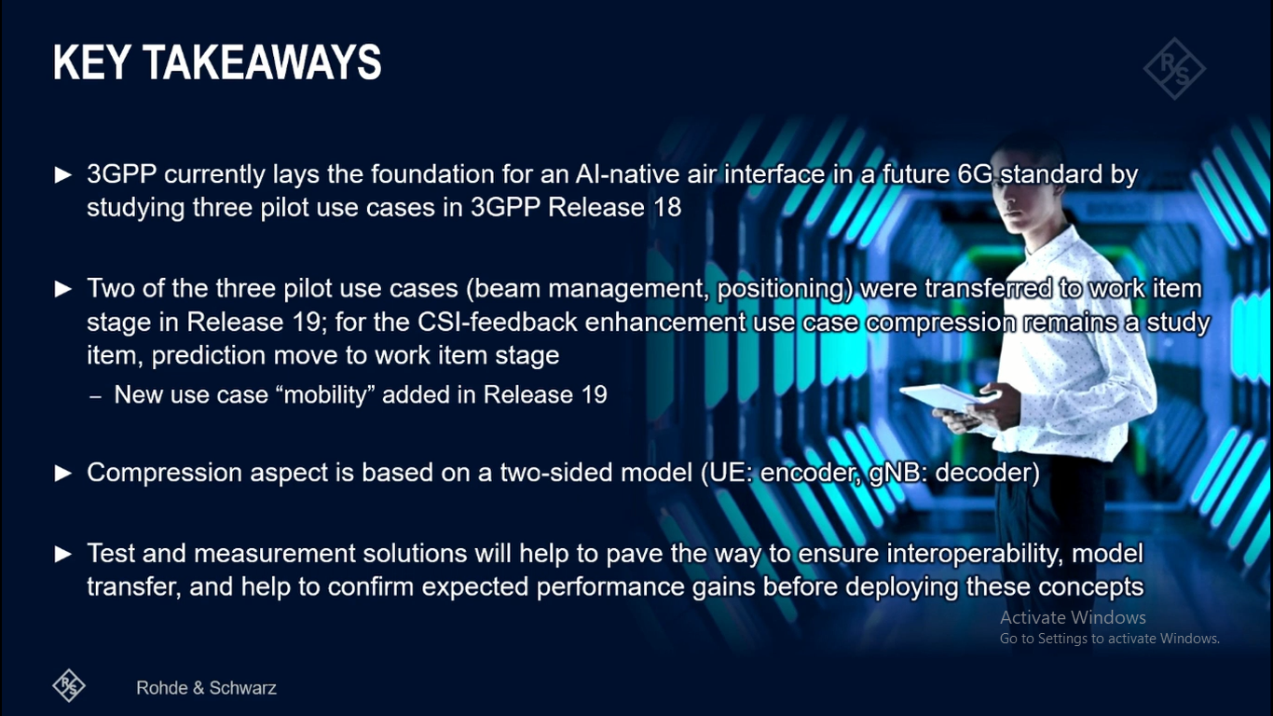

Slide 31
Outline of Presentation
Problem of Radio Wave Propagation : Case Study of a Specific Wireless Channel.
Solution for performance restoration against Problem of Radio Wave Propagation using Artificial Intelligence
Webinar by R&S : Towards an AI-native air interface in 6G
IIIT Kalyani work ‘ Smart Island Project ’ and realization of 5G NIB with One Cell Use Case
Compare R&S work ‘AI-native air interface in 6G’ with IIIT Kalyani work ‘ Smart Island Project ’

Slide 32
Two approaches followed for simulation based Compensation are discussed:-
APPROACH 1: Conventional Dual Frequency Diversity and MRC based Combining Approach
APPROACH 2: AI based Approach Single Frequency RF Carrier Approach instead of Two Carriers
The above problems associated with seawater radio waves are solved by frequency diversity technique following 3GPP release 18 specifications. Frequency diversity is the special feature of smart antenna technology that solves the problems related to fading depth.
By mixing the output from each antenna at the receiver, Frequency Diversity reconstructs the signal in this instance.
The fading compensator system design using an envelope adder and the MRC ( Maximum Ratio Combining) algorithm is shown in Figure 6.11.

Slide 33
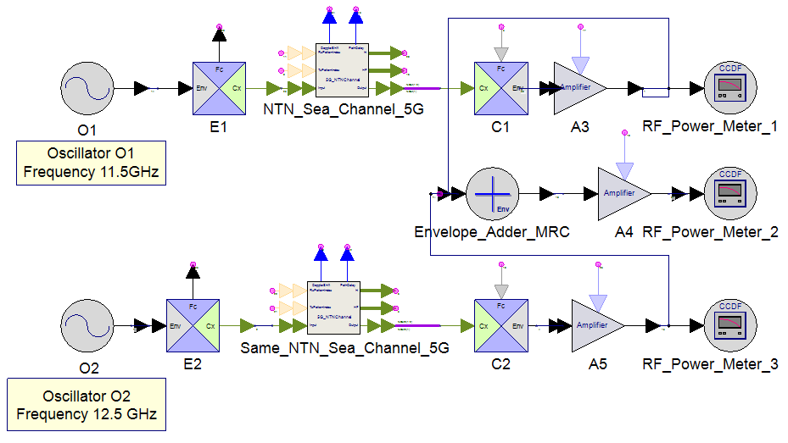
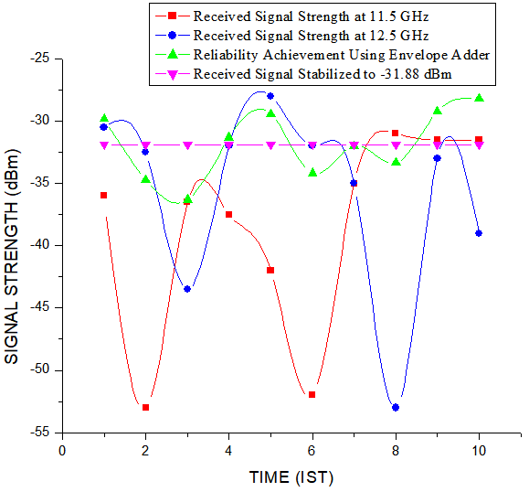
Fig. 6.11: Fading Compensator by MRC in Envelope Adder
Fig. 6.12: Reliability Achievement for the Problems in 5G NTN-SEA-SMIT Channel by MRC in Envelope Adder

Slide 34
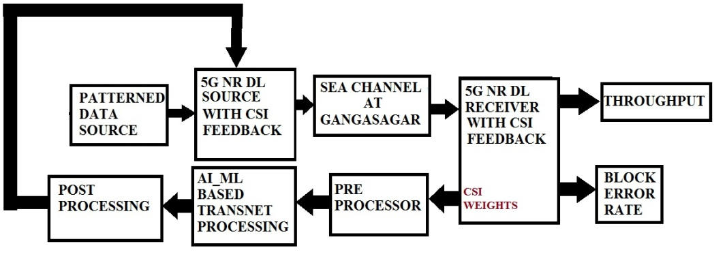
APPROACH 2: AI based Approach Single Frequency RF Carrier Approach instead of Two Carriers
: 5GNR_CSI_Feedback_TransNet
Figure 16: Compensation of Propagation Impairment of 5G SEA Channel using AI based Approach
The Block diagram in figure 16 is realized using keysight Systemvue 2024 Software tool where
• The upper row represents 5G NR Communication system accomplished with 5G NR DL source , Sea channel at Gangasagar (with measured Received Signal Stregth of the carrier frequencies 11.5/12.5 GHz along as experimented , 5G NR Receiver with CSI feedback , Throughput and BLER measurement.
• The lower row represents CSI weights from 5G NR receiver, Pre-processor, AI_Ml based Transnet processing and Post Processing and the feedback to 5G NR Source.

Slide 35
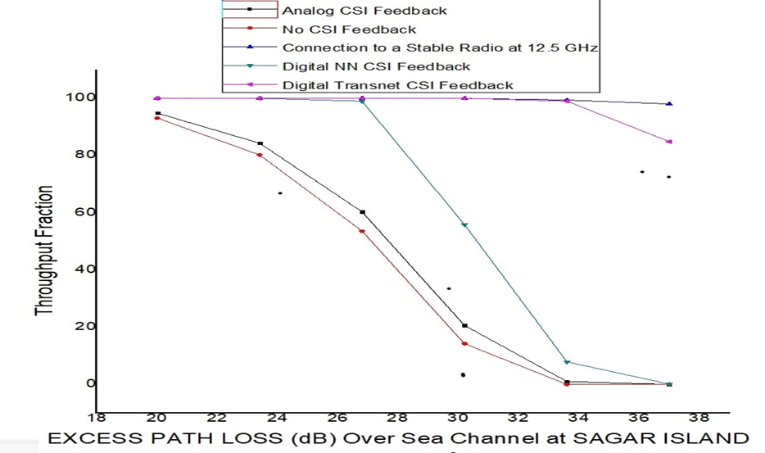
Figure 17 shows the Variation of Throughput Fraction over the simulation model of figure 16 where Excess Path Loss (dB) measured as experimented are inserted and plotted for different multiple scenarios
Figure 17 Variation of Throughput Fraction with Excess Path Loss (dB) Over Channel at Sagar Island

Slide 36
The four throughput fraction graphs of figure 17 are elaborated:-
Case 1: For Analog CSI Feedback and no CSI feedback[ Red and Black curve]
There will be decrease in throughput fraction from the initial stage.
Case 2:Connection to a stable radio at 12.5 GHz[ upper Blue curve]
The Throughput Fraction remains constant with the variation of excess path loss upto 38 dB. In this case, 11.5 GHz remains totally inactive. It specifies that in this stage, the reliability of the signal totally depends upon the frequency diversity.
Case 3: Digital NN CSI Feedback [ Green Curve]
For digital NN CSI Feedback, the throughput fraction is maximum up to Excess Path Loss of 28 dB. After this stage, the throughput fraction starts to decrease.
Case 4: Digital TRANSNET CSI Feedback [ PINK Curve]
On the other hand, for digital Transnet CSI Feedback, the throughput fraction is maximum up to Excess Path Loss of 34 dB. After this stage, the throughput fraction starts to decrease.
Hence an interesting simulation results dictates that the digital Transnet Feedback gives a good support for the evaluation of reliability.
Thus, we can replace (optionally) the use of 2nd radio with the implementation of Transnet realized using GPU within the 1st radio only.
Conventional frequency Diversity and MRC based Approach following APPROACH 1 should use two radios at 11.5 and 12.5 GHz . Optionally, AI based Approach following APPROACH 2 should use only One radio at 12.5 GHz alongwith Transnet based AI for the better 5G reliability.

Slide 37
Outline of Presentation
Problem of Radio Wave Propagation : Case Study of a Specific Wireless Channel.
Solution for performance restoration against Problem of Radio Wave Propagation using Artificial Intelligence in 3GPP 5G-Advanced
Artificial Intelligence in 3GPP 5G-Advanced: A Survey
Webinar by R&S : Towards an AI-native air interface in 6G
IIIT Kalyani work ‘ Smart Island Project ’ and realization of 5G Summary and Conclusion with Five Cell Use Case
Compare R&S work ‘AI-native air interface in 6G’ with IIIT Kalyani work ‘ Smart Island Project ’
Summary and Conclusion

Slide 38
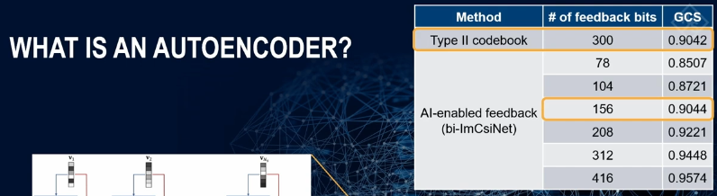
Research Contribution of R&S and IIIT Kalyani work ‘ Smart Island Project ’
Research Contribution of R&S |  | R&S concentrates on Real Time Operation using AI Autoencoder for CSI Feedback Compression
Research Contribution of IIIT Kalyani work ‘ Smart Island Project ’ | APPROACH 1: Conventional MMSE based 12.5 GHz Radio and 11.5 GHz Radio Approach 2:11.5 GHz radio not Required using AI based Auto encoder and only 12.5 GHZ rdaio will ensure Relaiability in service continuity for sea Channel | IIIT KALYANI concentratres on Cost Reduction using One AI enabled radio at 12.5 GHz ,instead of using Two radios with Conventional Approach under Sea Channel condition

Slide 39
NEXT CLASS : 5G USE CASE 2: ITEM 2 with THREE CELLs (Service Continuity) and ITEM 3 with 5th CELLS (Congestion Avoidance)

Slide 40
CLASS 9
Dated 26t h FEBRUARY , 2025
Course Title: 5G and Wireless Technology
Course Code : ECE829
MODULE 4 of the Syllabus:-
5G Use Case 2: IIIT KALYANI’s 5G Smart Gangasagar Island Project with Large Rack 5G , Small Portable NIBs and their integration
to solve problems of
i) Ultra Reliability using AI at Underserved Areas in Vessels/Boats ii) Service Continuity at Unserved Areas in Mid Sea iii)Congestion Avoidance at Crowd areas like Kapil Muni ashram,Gangasagar
Prof.(Dr.) Rabindranath Bera (Professor, IIIT, KALYANI)
E-mail: rbera@iiitkalyani.ac.in; Mobile : 9475513358
i

